Slide 1
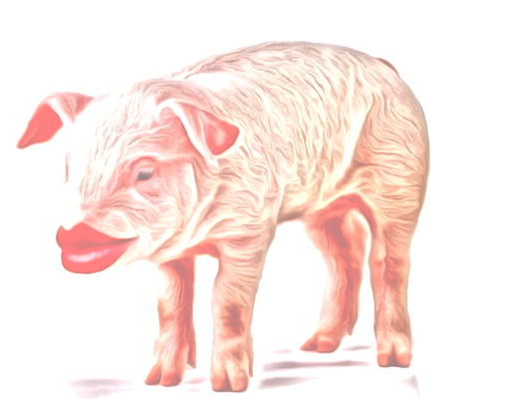
Empower the Pig - Don't Disturb the Lipstick
Ben Langhinrichs, President of Genii Software

Slide 2
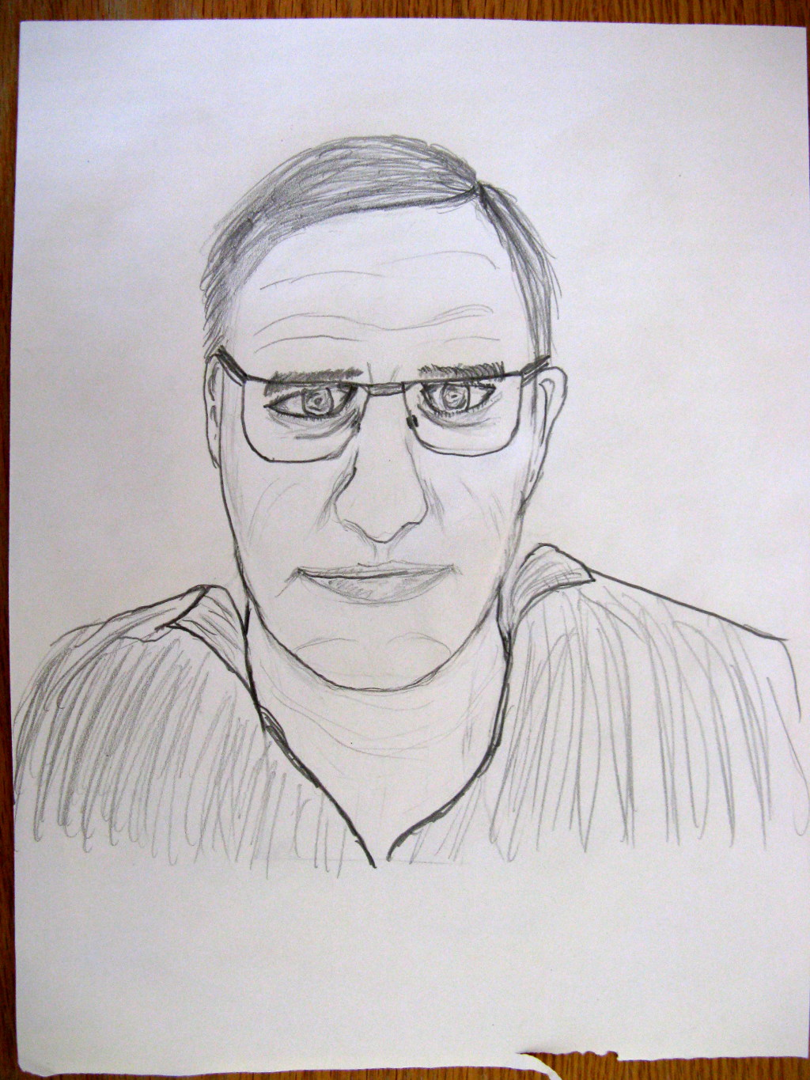
Introduction – Ben Langhinrichs

Slide 3
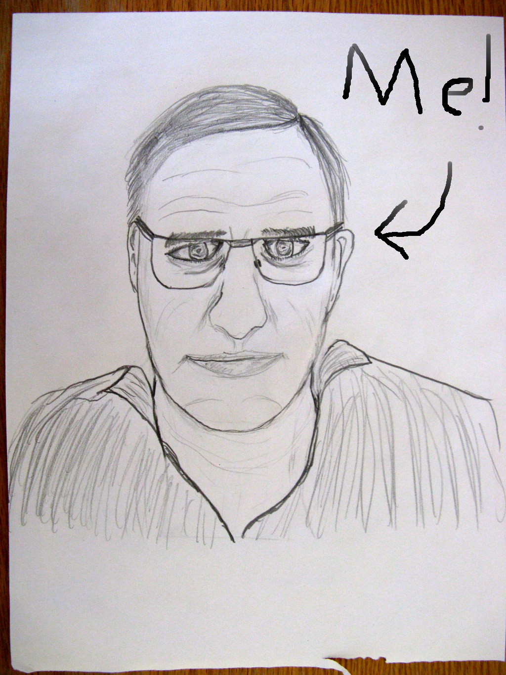
Introduction – Ben Langhinrichs

Slide 4
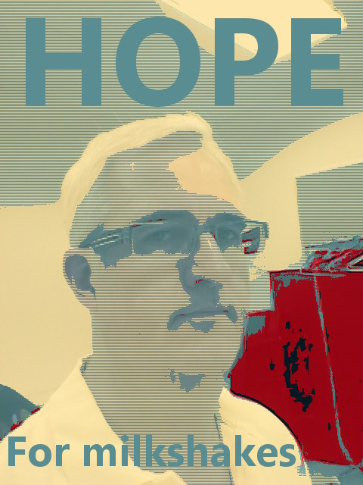
Introduction – Ben Langhinrichs

Slide 5
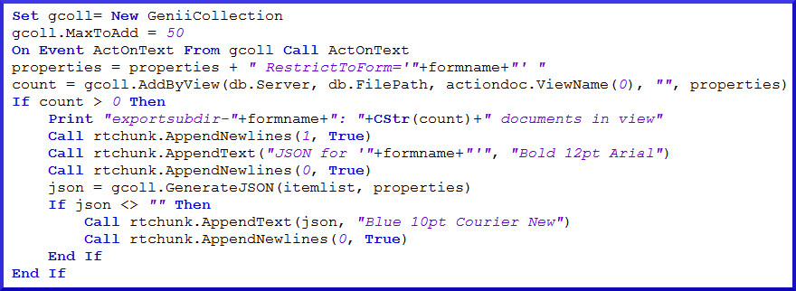
Midas LSX & Midas C++
Midas LSX: Adding functionality to LotusScript since R4
Midas C++: Adding functionality to C++/Java/etc. since R5

Slide 6
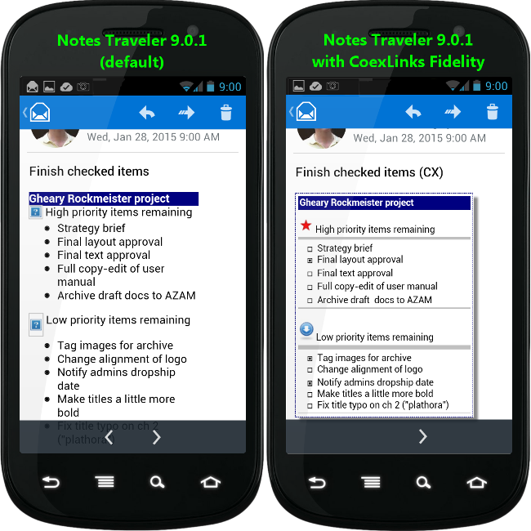
CoexLinks Fidelity
CoexLinks Fidelity: Because recipients should see what you sent

Slide 7
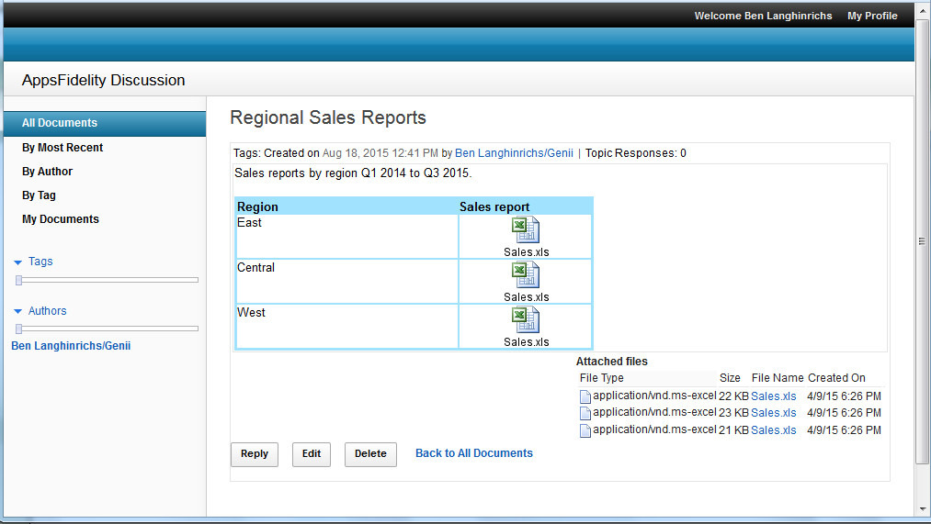
CoexLinks Fidelity
AppsFidelity: Because fidelity matters for applications, too

Slide 8
Speed Dating vs. Time Together
Software is all about relationships. It starts with dating.

Slide 9
Speed Dating vs. Time Together
If all goes well, you get married and start a family.
Not ignoring same-sex marriage or those who don’t have children, or the lack of pets. It’s an analogy, folks. If it doesn’t fit, don’t wear it.

Slide 10
Speed Dating vs. Time Together
Your dependencies grow and multiply as your relationship matures.

Slide 11
Speed Dating vs. Time Together
Eventually, your dependencies start to leave the nest. One day, you look at each other and say, “Do we still want this?”
Do you have the energy to start over with someone new? Do you have the energy to do what it takes to stay? Both take effort.

Slide 12
Imagine the future
DaterCreatr
Swipe right on “Enjoys movies”
Swipe left on “Loves to dance”
Swipe right on “Likes bourbon neat”
Swipe left on “Posts inspirational quotes”

Slide 13
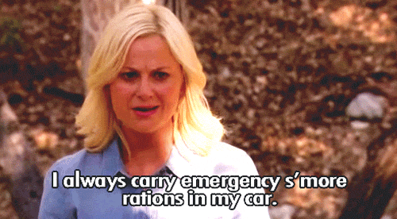
Not all roses and chocolate
DaterCreatr
You can’t ask about every odd little thing that may be important. That is when the DaterCreatr API comes in handy.

Slide 14
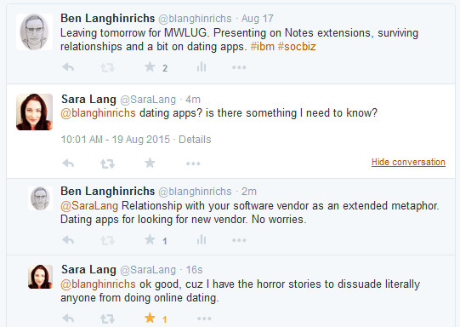
Not all roses and chocolate
But wait…

Slide 15
Invest in your relationship?
You already have a relationship that works pretty well.
Sure, the software’s gained a little weight. Maybe even sags a little here and there.
But what about you? You could maybe try a little harder. When was the last time you hired a new developer?
Truth is, you and your software fit well together, and you don’t really want to argue again about who gets the covers.
That’s when you realize your current software has an API, too.

Slide 16
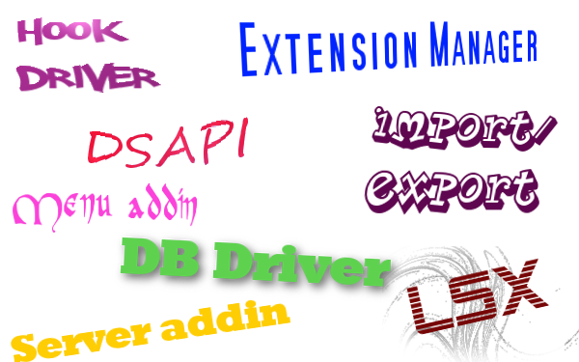
C API extension points

Slide 17
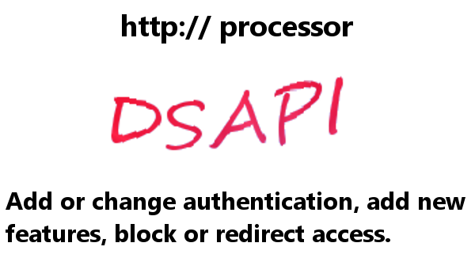
C API extension points
Notes:
Add password to particular db/resource, custom Single Sign On, masking Domino, retrieving content in different formats.

Slide 18
C API extension points

Slide 19
Reaching for the pig analogy
The hidden favor IBM has done for you (without meaning to)

Slide 20
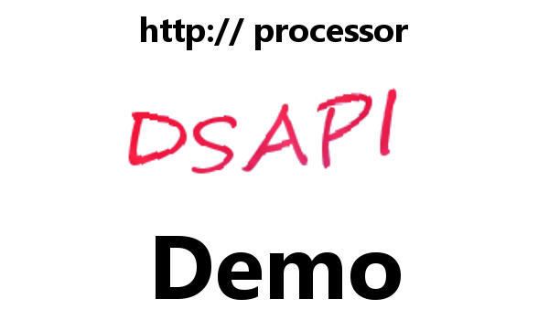
Bacon Bits

Slide 21
Bacon Bits
http://whatever.com/path/db.nsf/view/unid/$Links.html

Slide 22
Bacon Bits
http://whatever.com/path/db.nsf/view/unid/$Links.json
{"DisplayLinks": {
"links": [ {"replica": "885257B620001FEF",
"viewUNID": "34027A0E7C5B464885257B620001FEF2",
"UNID": "29177C537F8C06D885257B5F005B4A7A",
"foundText": “Subject info" } ],
"Count": 1
}}

Slide 23
C API extension points

Slide 24
Bacon Bits

Slide 25
Bacon Bits

Slide 26
C API extension points

Slide 27
Throw in some Star Wars
The event manager traps a specific event in a specific process. Use the specificity, Luke!

Slide 28
Bacon Bits

Slide 29
Obligatory nod to the Doctor

Slide 30
C API extension points

Slide 31
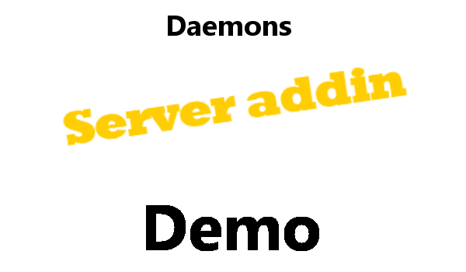
Bacon Bits

Slide 32
C API extension points

Slide 33
OMG, a screenshot demo?
Processing mail using specific events in specific process.

Slide 34
C API extension points

Slide 35
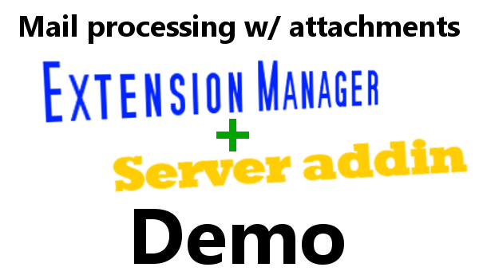
C API extension points

Slide 36
C API extension points
I imagine some of you are asking, “Are we there yet?”
No, but we are getting close.

Slide 37
C API extension points

Slide 38
C API extension points

Slide 39
Bacon Bits

Slide 40
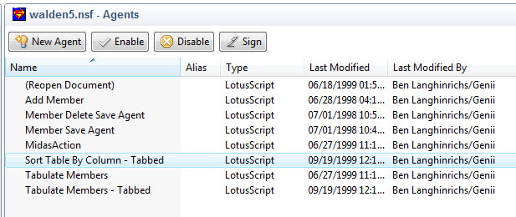
Lord love a duck, R5?

Slide 41
C API extension points

Slide 42
Pork rinds

Slide 43
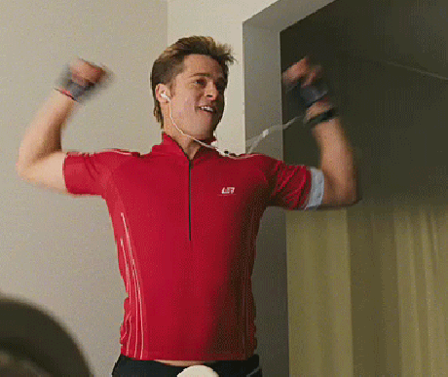
Celebration time
You made it!
(at least those who didn’t quit half an hour ago to check FB)

Slide 44
Q&A

Slide 45
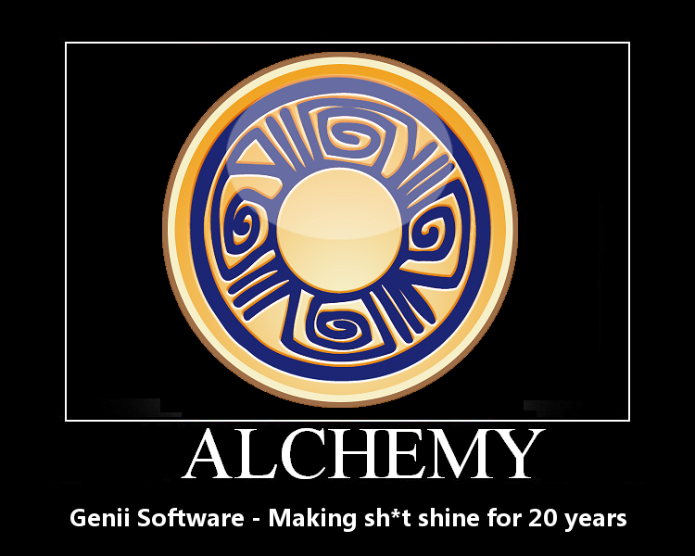
More information

