Slide 1
Ben Langhinrichs, President of Genii Software

Slide 2
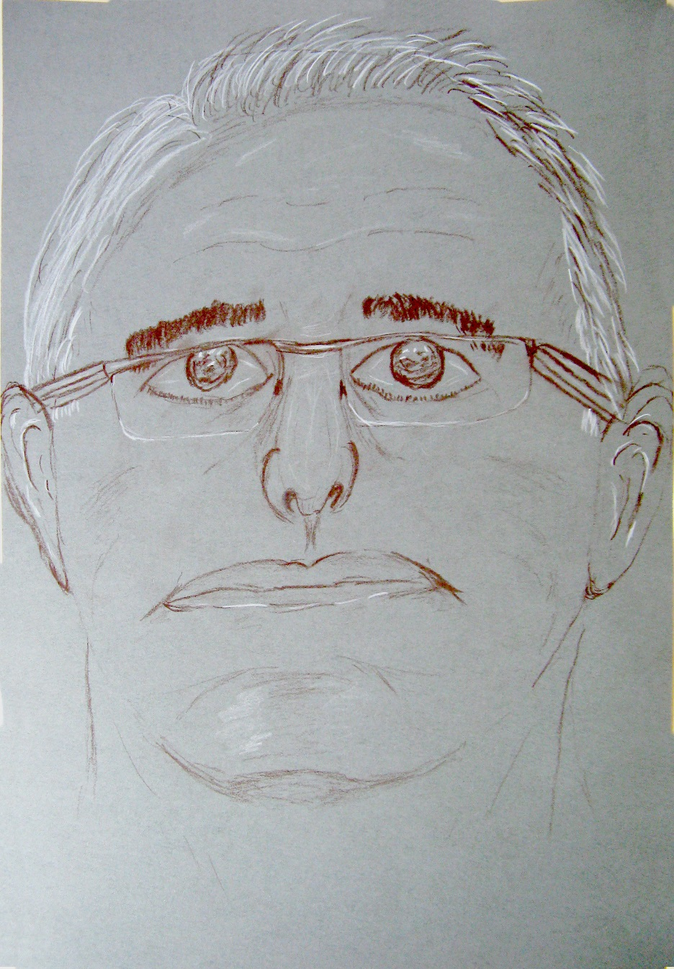
Introduction
Ben Langhinrichs, Genii Software

Slide 3
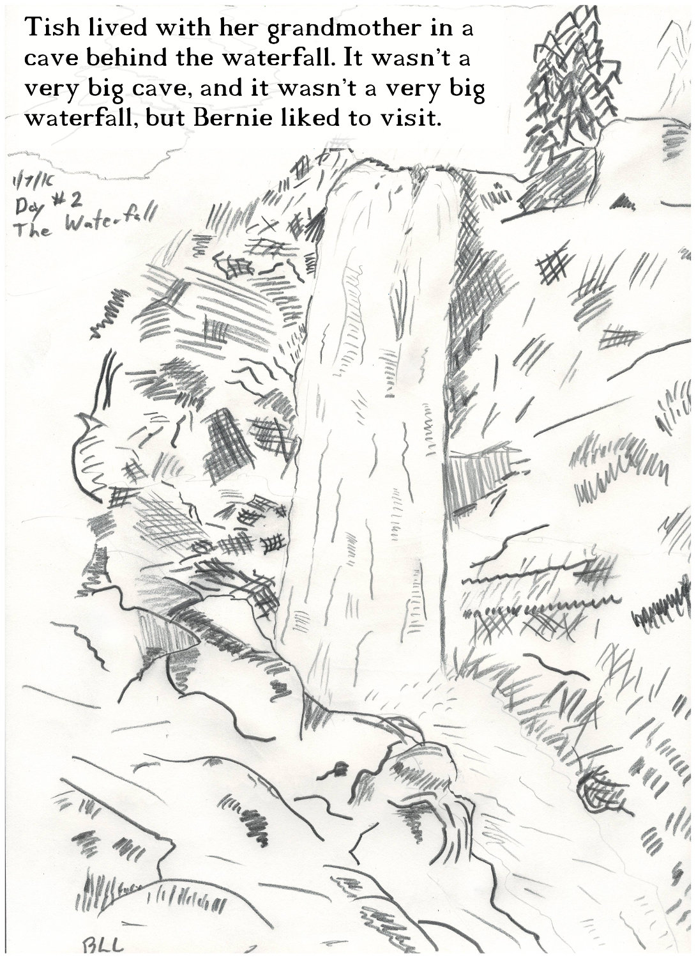
When I am not developing software, I write children’s books and draw pictures.

Slide 4
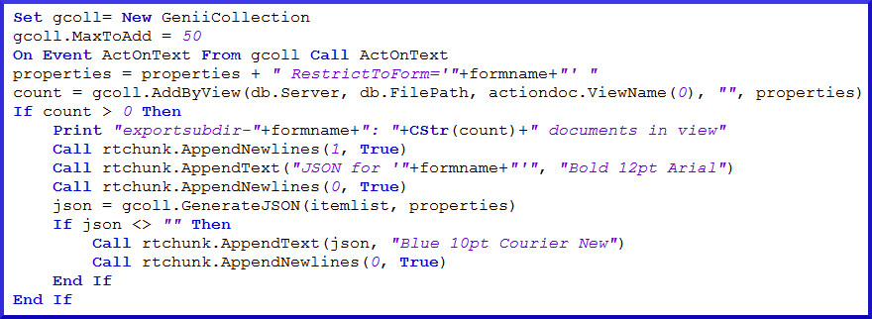
Midas LSX & Midas C++
Midas LSX: Adding functionality to LotusScript since R4
Midas C++: Adding functionality to C++/Java/etc. since R5

Slide 5
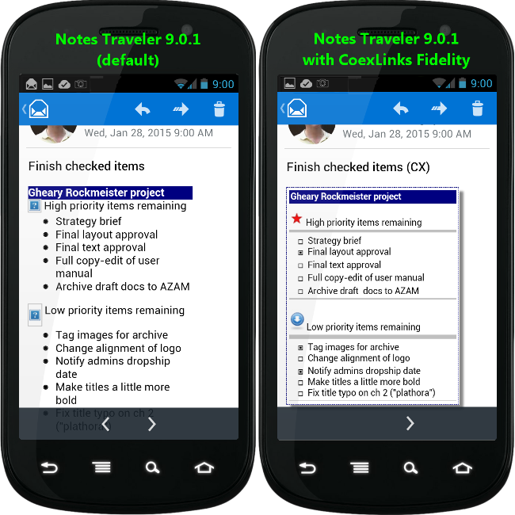
CoexLinks Fidelity
CoexLinks Fidelity: Recipients should see what you sent

Slide 6
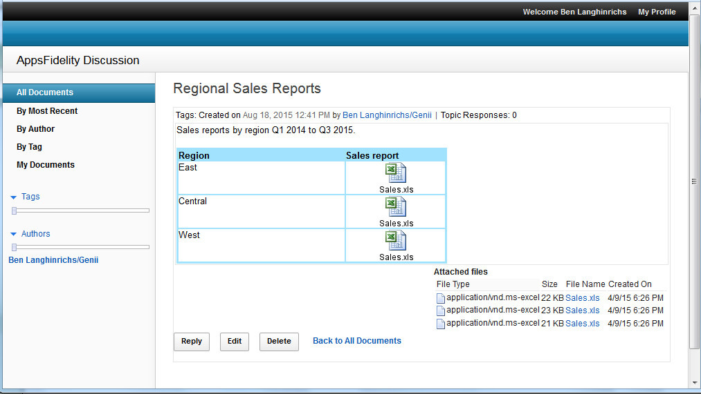
AppsFidelity
AppsFidelity: Fidelity matters for applications, too

Slide 7
Vendors & Customers
Software is all about relationships. It starts with dating.

Slide 8
Vendors & Customers
If all goes well, you get married and start a family.
Not ignoring same-sex marriage or those who don’t have children, or the lack of pets. It’s an analogy, folks. If it doesn’t fit, don’t wear it.

Slide 9
Vendors & Customers
Your dependencies grow and multiply as your relationship matures.

Slide 10
Vendors & Customers
Eventually, your dependencies start to leave the nest. One day, you look at each other and say, “Do we still want this?”
Do you have the energy to start over with someone new? Do you have the energy to do what it takes to stay? Both take effort.

Slide 11
Imagine the future
DaterCreatr
Swipe right on “Enjoys movies”
Swipe left on “Loves to dance”
Swipe right on “Likes bourbon neat”
Swipe left on “Posts inspirational quotes”

Slide 12
Not all roses and chocolate
DaterCreatr
You can’t ask about every odd little thing that may be important. That is when the DaterCreatr API comes in handy.

Slide 13
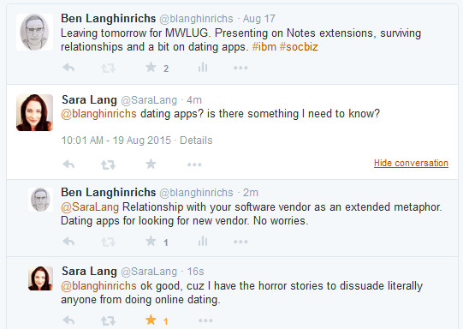
Not all roses and chocolate
But wait…

Slide 14
Invest in your relationship?
You already have a relationship that works pretty well.
Sure, the software’s gained a little weight. Maybe even sags a little here and there.
But what about you? You could maybe try a little harder. When was the last time you hired a new developer?
Truth is, you and your software fit well together, and you don’t really want to argue again about who gets the covers.
That’s when you realize your current software has an API, too.

Slide 15
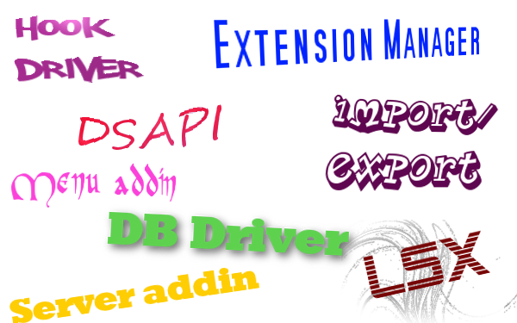
C API extension points

Slide 16
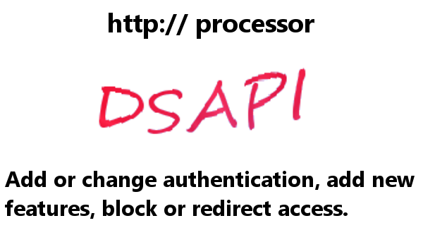
C API extension points
Notes:
Add password to particular db/resource, custom Single Sign On, masking Domino, retrieving content in different formats.

Slide 17
C API extension points

Slide 18
The (not so secret) secret
The hidden favor IBM has done for you (without meaning to)

Slide 19
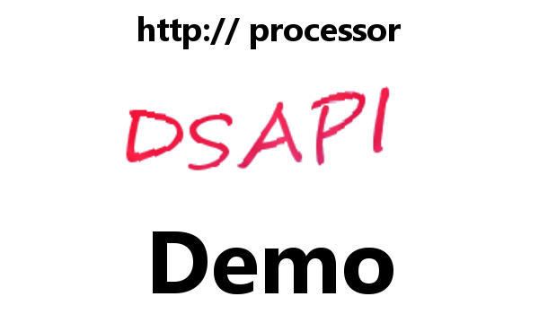
Turbocharge – DSAPI

Slide 20
Turbocharge – DSAPI
http://whatever.com/path/db.nsf/view/unid/$Links.html

Slide 21
Turbocharge – DSAPI
http://whatever.com/path/db.nsf/view/unid/$Links.json
{"DisplayLinks": {
"links": [ {"replica": "885257B620001FEF",
"viewUNID": "34027A0E7C5B464885257B620001FEF2",
"UNID": "29177C537F8C06D885257B5F005B4A7A",
"foundText": “Subject info" } ],
"Count": 1
}}

Slide 22
Turbocharge – DBDRVR

Slide 23
Turbocharge – DBDRVR

Slide 24
Turbocharge – DBDRVR

Slide 25
Turbocharge – EXTMGR

Slide 26
Throw in some Star Wars
The event manager traps a specific event in a specific process. Use the specificity, Luke!

Slide 27
Turbocharge – EXTMGR

Slide 28
Obligatory nod to the Doctor

Slide 29
Turbocharge – SRVRADDIN

Slide 30
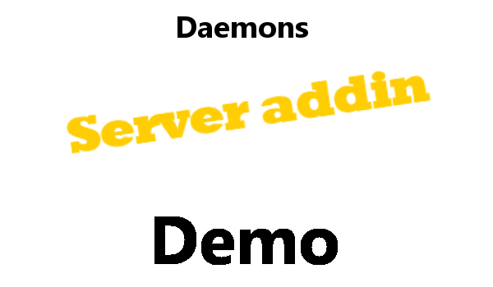
Turbocharge – SRVRADDIN

Slide 31
Turbocharge – EXTMGR

Slide 32
OMG, a screenshot demo?
Processing mail using specific events in specific process.

Slide 33
Turbocharge – EXTMGR+ADDIN

Slide 34
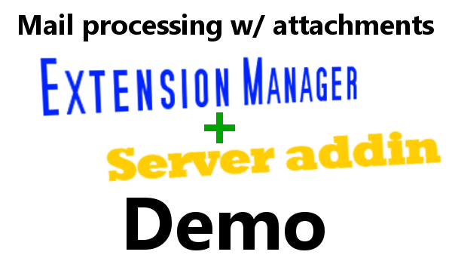
Turbocharge – EXTMGR+ADDIN

Slide 35
C API extension points
I imagine some of you are asking, “Are we there yet?”
No, but we are getting close.

Slide 36
Turbocharge – HOOK DRVR

Slide 37
Turbocharge – LSX

Slide 38
Turbocharge – LSX

Slide 39
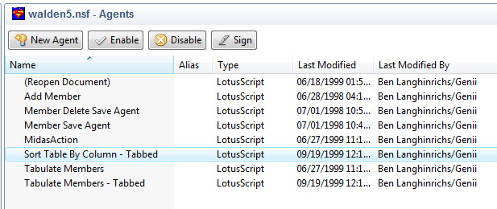
Lord love a duck, R5?

Slide 40
Turbocharge – MENU ADDIN

Slide 41
Turbocharge – MENU ADDIN

Slide 42
Celebration time
You made it!
(at least those who didn’t quit half an hour ago to check FB)

Slide 43
Q&A

Slide 44
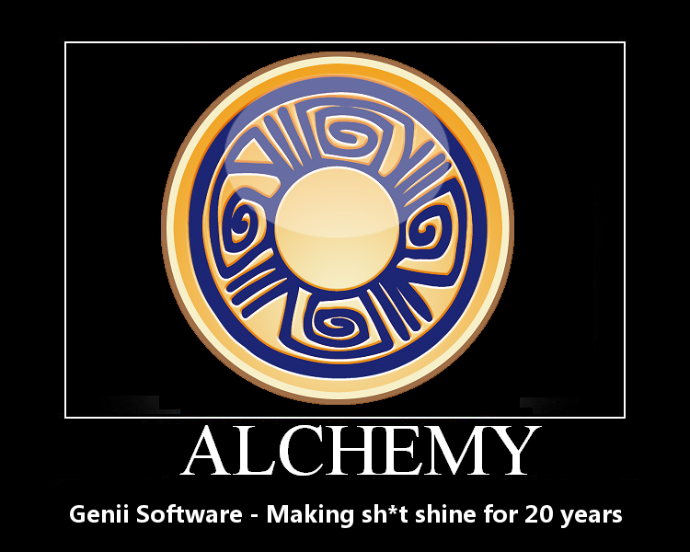
More information

